Slide 1
Lesson 2 - Autonomous
The method of time is timeless
Ben Schwarz

Slide 2
How does Autonomous Work
Very Simple, Instructions are provided for the robot to do in a logical order.
How you decide what the instructions are or what order they are done is up to you!

Slide 3
How can we control the robot?
Here is the challenge. We need the robot to go forward turn 90 drive forward turn 85 degrees and then outtake a cube.
How do we know when to turn. How do we know how far to go.
What techniques do we have?

Slide 4
Dead Reckoning
4613
2m
Goal
Distance = 2m
Speed = 0.5m/s
2m / 0.5 (m/s) = 4 seconds
Just drive at full speed for 4 seconds and we will be at the goal.

Slide 5
So how do we code this?
Copy and paste the linearOpMode template (pushbotautodrivebytime_linear) into your code.
Gut everything after waitforStart() to the sleep command.
Replace the hardwaremap line with tutorial hardwaremap. You should know how to do this from last lesson. (If not look at the Teleop mode)

Slide 6
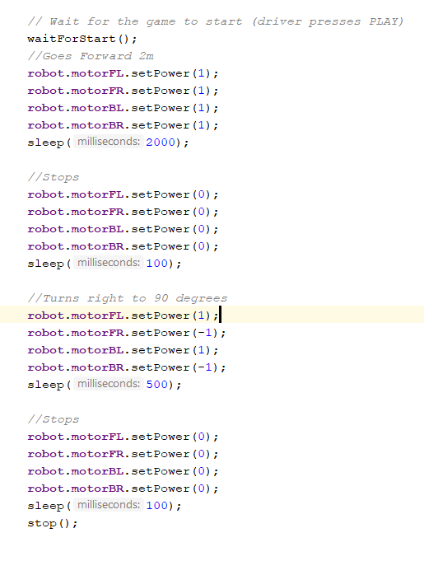
Going Forward and Turn.
Try this now

Slide 7
Okay... Does anyone see a problem?
This gets really repetitive really quick.
Not to mention lots and lots of unnecessary code.
Solution: METHODS!
If you do not know how they work, please read my powerpoint on them (or Sean’s, or Matt’s or anything on the web)

Slide 8
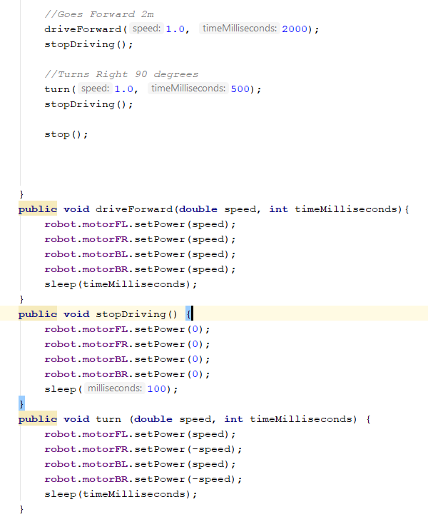
Same thing but with methods

Slide 9
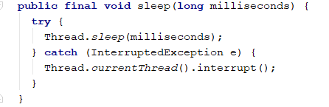
Deeper Look at FTC coding
The sleep function calls this function:
The FTC app is multithreaded.
The thread which handles changing motor and servo values (i.e. the thread which runs your code) of the robot is essentially disabled for the period of time specified
Essentially the thread which runs our code, sets values for components on the robot and a different thread takes these values and applies it to the motors and other parts of the robot.

Slide 10
Challenges
Drive forward 2m
Turn right 90 degrees.
Drive forward 1m
Outtake Cube.
Tip: Test everything in modules. Don’t try and do it all at once.

